Slide 1

LINUX SYSTEM AND NETWORK ADMINISTRATION
RHCSA/RHCE
https://itsfoss.com/linux-runs-top-supercomputers/

Slide 2
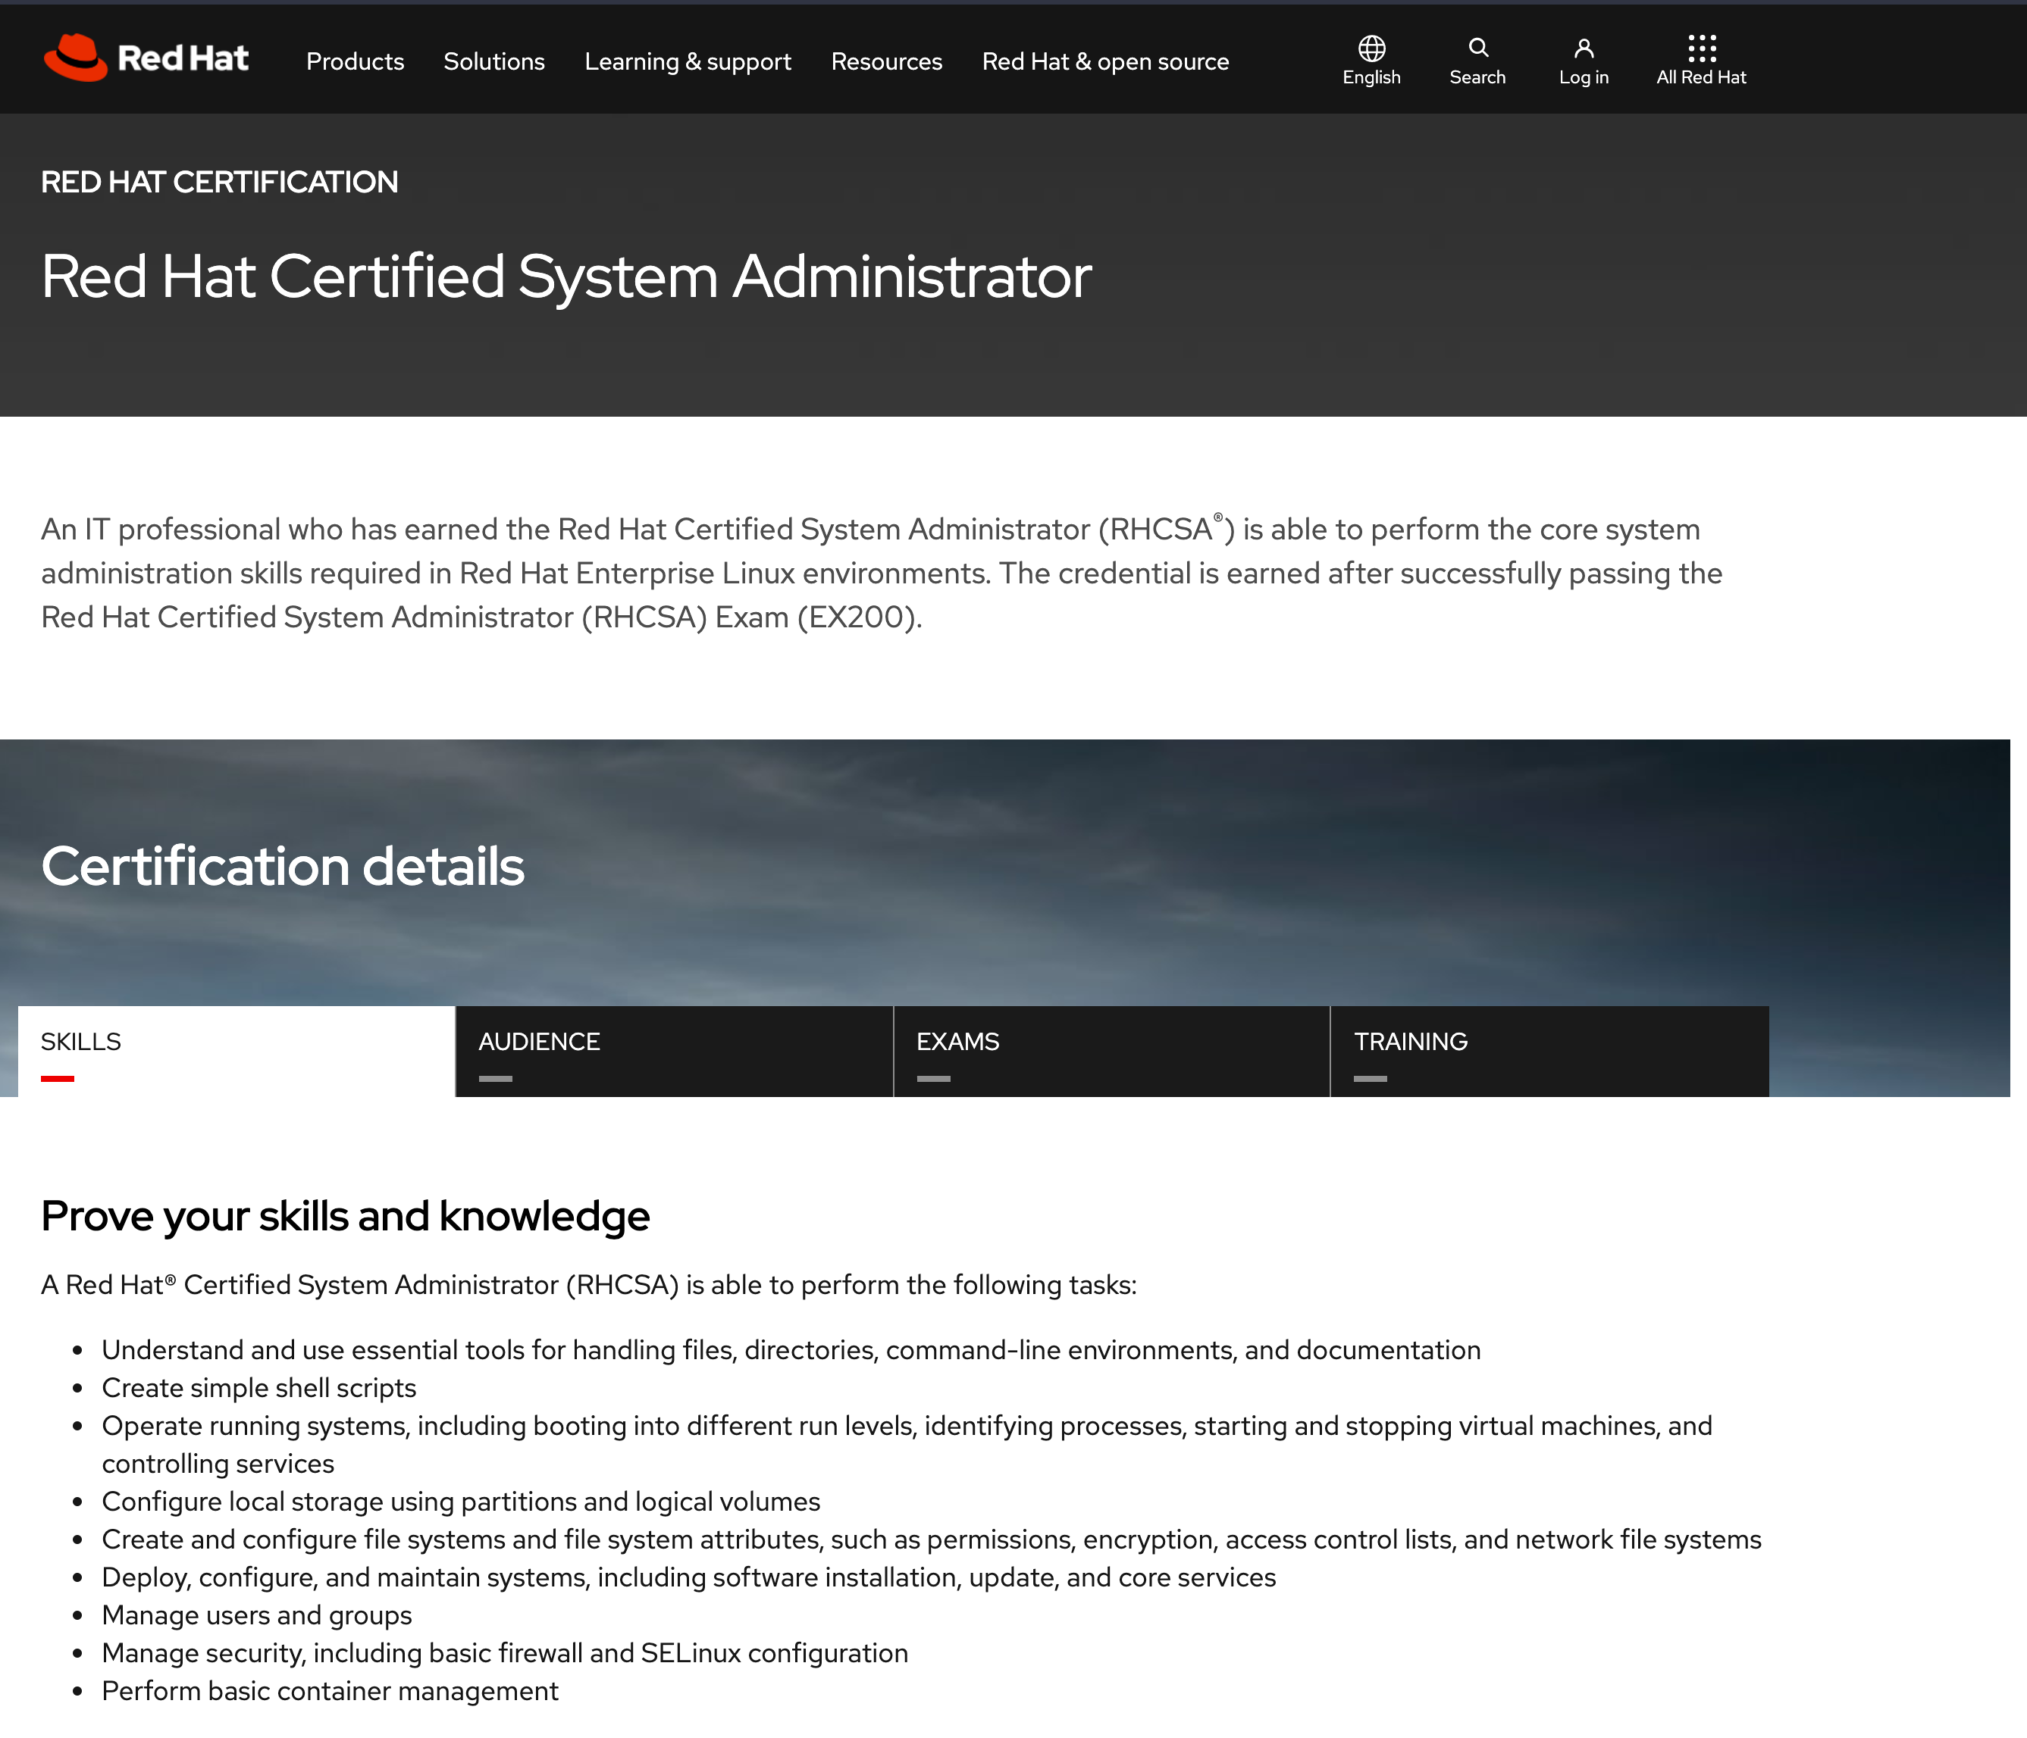
RHCSA

Slide 3
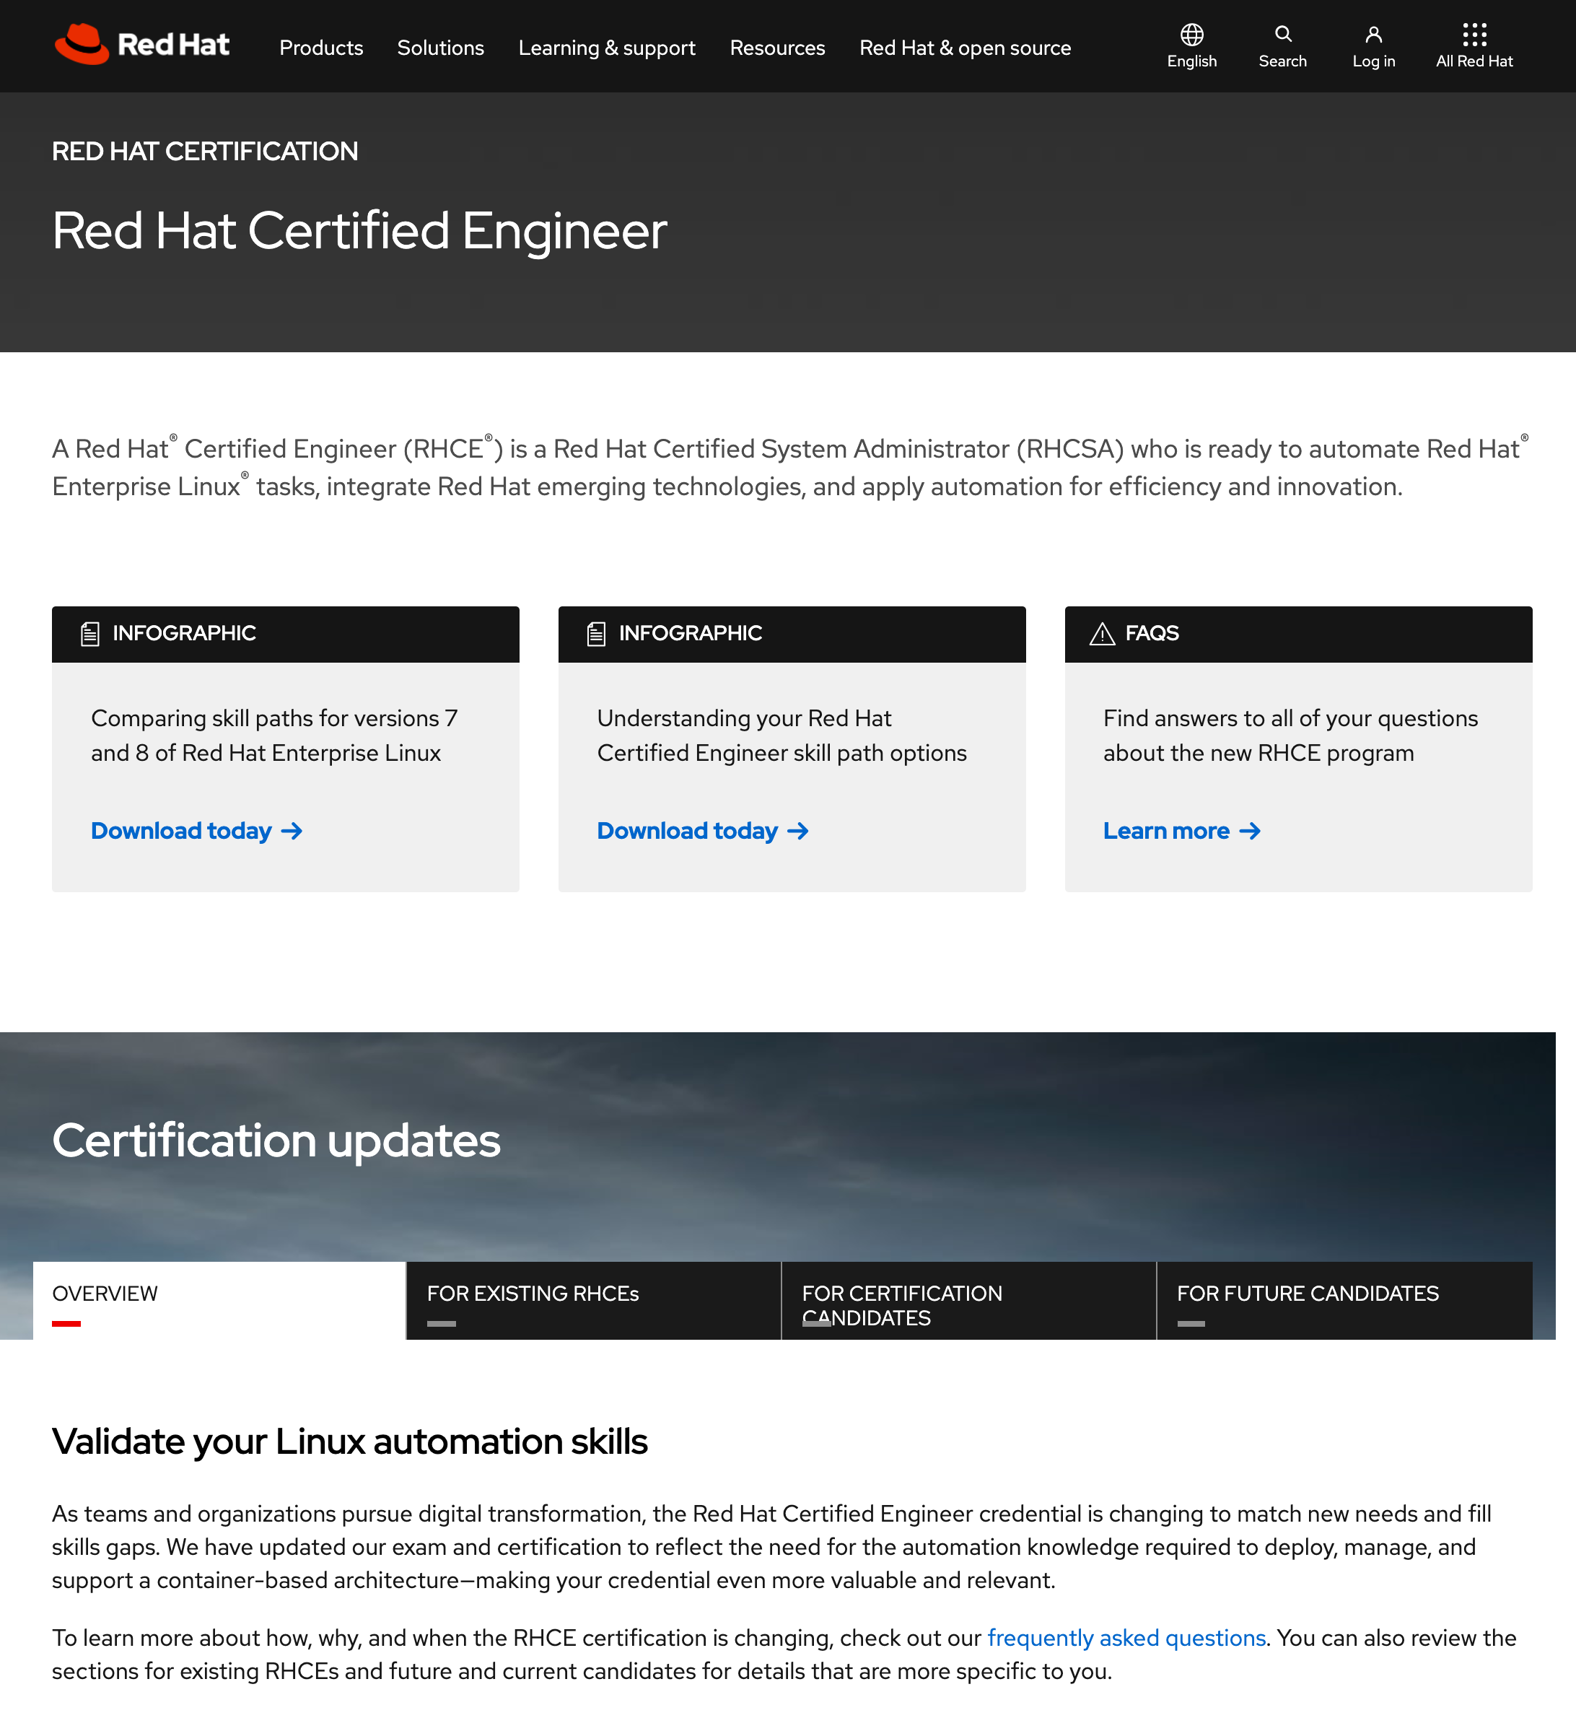
RHCE

Slide 4
Module I. RHCSA
Course Content
Lecture/Lab 1
Introduction to UNIX - UNIX Operating System Architecture
Linux Operating System
Users, Groups and Permissions - Examining Permissions
Lecture/Lab 2
Linux Installation
Hard Disk Partition Details
Linux File System - ext2 / ext3 / ext4 / xfs
Dual Boot Installation
Lecture/Lab 3
Desktop Familiarization - Text and GUI Mode - Virtual Terminals - GNOME and KDE Desktop

Slide 5
Module I. RHCSA
Course Content
Lecture/Lab 4 & 5
UNIX Shell
UNIX Commands
Shell Commands - File System Management - File Management and Viewing - Help, Job and Process Management - Network Management - System Management - User Management - Printing and Programming - Document Preparation - Miscellaneous
Lecture/Lab 6
System Initialization and Services - Boot Sequence, Runlevels & Daemon Processes
User Administration - User Creation/ Suspension & Deletion - Group Administration

Slide 6
Module I. RHCSA
Course Content
Lecture/Lab 7
Network Configuration - Configuration Utilities - Multiple NICs
Task Schedulers - cron daemons
Disk quota management
Backup and Restore
Lecture/Lab 8
Adding and Removing Software Packages
RPM Package Management
Setting Printer
System Monitoring - File System Analysis - System Log Files & Analysis
System Troubleshooting - Filesystem Corruption and Recovery - Things to check: The X Window System - Service, Networking & Booting - The Rescue Environment - Recovery Runlevels

Slide 7
Module II.RHCE
Course Content
Lecture/Lab 9
DHCP - Server setup - Client setup
NIS - NIS Server setup - NIS Client setup
Lecture/Lab 10
NFS - NFS Server & Client configuration - autofs implementation
Samba Server - File & Print Service
Lecture/Lab 11
Basic Concept of DNS - Implementation of BIND - forward & reverse lookup - DNS Directives

Slide 8
Module II.RHCE
Course Content
Lecture/Lab 12
Apache Web Server - Basic Configuration - Name based Virtual Hosting - Restriction through htaccess
Lecture/Lab 13
Sendmail - Mail Server - Configuring mail service - SMTP Server
POP3 / IMAP Server
Lecture/Lab 14
Proxy Server - Squid - ACL for restricting access
Lecture/Lab 15
Linux System as a Router - Setup and configuration - Static Routing
SELinux Configuration
Firewall Using firewalld/IPTables - Filter and NAT rules

Slide 9
Course Schedule
Schedule
The complete course, including Lectures and Labs, will be covered in 60 Hours.
The total duration of the course will be 3.5 - 4 months.
Lectures/Labs : Every Friday, 16:00 – 18:00 P.M
Labs : Friday late, 18:00 – 20:00 P.M

Slide 10
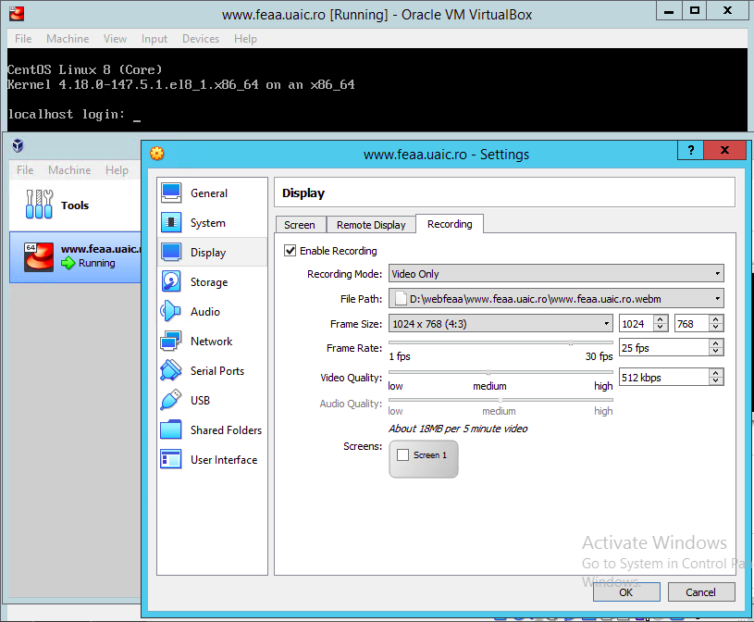
Grading Guidelines
Grading
One Practical Exam: 80% (Moodle Video recording - webm Virtual Box(60%)+/- OBS Studio - 28 mai + Moodle Quiz (20% ) - 24 mai)
Lab Exercises: 20% (video recording - webm)
Minimum 80% attendance.

Slide 11
References
Course References
Online on the Web
The Linux Documentation Project (LDP), http://www.tldp.org/
Mirror: http://www.iitk.ac.in/LDP
Red Hat Linux, O'Reilly
The course slides will be available at http://portal.feaa.uaic.ro/Master/SIA/anul1/zsem2/linux/Pages/default.aspx

Slide 12
UNIX/LINUX OPERATING SYSTEM
Introduction to Linux
Introduction to Unix
History of UNIX
What is LINUX
LINUX Distributions
Unix OS Structure
Unix File System
Unix Directories, Files and Inodes
Users, Groups and Permissions

Slide 13
UNIX
Introduction to Linux
Unix is a multi-user, multi-tasking operating system.
You can have many users logged into a system simultaneously, each running many programs.
It's the kernel's job to keep each process and user separate and to regulate access to system hardware, including cpu, memory, disk and other I/O devices.

Slide 14
History of UNIX
Introduction to Linux
First Version was created in Bell Labs in 1969.
Some of the Bell Labs programmers who had worked on this project, Ken Thompson, Dennis Ritchie, Rudd Canaday, and Doug McIlroy designed and implemented the first version of the Unix File System on a PDP-7 along with a few utilities. It was given the name UNIX by Brian Kernighan.
00:00:00 Hours, Jan 1, 1970 is time zero for UNIX. It is also called as epoch.

Slide 15
History of UNIX
Introduction to Linux
1973 Unix is re-written mostly in C, a new language developed by Dennis Ritchie.
Being written in this high-level language greatly decreased the effort needed to port it to new machines.

Slide 16
History of UNIX
Introduction to Linux
1977 There were about 500 Unix sites world-wide.
1980 BSD 4.1 (Berkeley Software Development)
1983 SunOS, BSD 4.2, System V
1988 AT&T and Sun Microsystems jointly develop System V Release 4 (SVR4). This later developed into UnixWare and Solaris 2.
1991 Linux was originated.(https://distrowatch.com/)

Slide 17
What is LINUX
Introduction to Linux
Linux is a free Unix-type operating system originally created by Linus Torvalds with the assistance of developers around the world.
It originated in 1991 as a personal project of Linus Torvalds, a Finnish graduate student.
The Kernel version 1.0 was released in 1994 and today the most recent stable version is 2.6.9
Developed under the GNU General Public License , the source code for Linux is freely available to everyone.

Slide 18
LINUX Distributions
Introduction to Linux
RedHat: http://www.redhat.com/
Fedora: https://getfedora.org/
SuSE/Novell: http://www.suse.com/
Debian: http://www.debian.org/
Ubuntu: https://ubuntu.com/
Red Hat Enterprise Linux is a Enterprise targeted Operating System. It based on mature Open Source technology and available at a cost with one year Red Hat Network subscription for upgrade and support contract. (CentOS - free alternative)
Notes:
The most important things that you get in the official RHEL 8 Server release is access to the Red Hat Customer Portal. Through this portal, you have access to a wide variety of information regarding RHEL, in addition to updates provided through Red Hat Network (RHN). In particular, the Red Hat knowledge base is invaluable; you can use it to find answers to many common problems that have been posted there by Red Hat consultants.
CentOS is the Community Enterprise Operating System. CentOS started as a recompiled version of RHEL, with all items that were not available for free removed from the RHEL software. Basically, just the name was changed and the Red Hat logo (which is proprietary) was removed from all the CentOS software packages. The result, still available today as CentOS 8, is an operating system that offers the same functionality as RHEL but is available for free (and without the enterprise support services).
CentOS is not the only distribution that offers Red Hat packages without your having to pay for them. Another commonly used Linux distribution that was free—but based on the Red Hat Enterprise Linux packages—was Scientific Linux, a Linux distribution that was developed at Fermi National Accelerator Laboratory. Scientific Linux has been discontinued, and there is no Scientific Linux version that matches the Red Hat Enterprise Linux 8 software.
Another Linux distribution closely related to Red Hat Enterprise Linux is Fedora, a completely open source Linux distribution that is available for free. Fedora offers access to the latest and greatest software, which in most cases is much more recent than the thoroughly tested software components of RHEL (which is why you should not use Fedora to prepare for the RCHSA exam)

Slide 19
LINUX - Access to Repositories
Introduction to Linux
repository - the installation source used for installing software.
CentOS - repositories are automatically set up, and no further action is required.
Red Hat Enterprise Linux - with a subscription, you’ll need to use the Subscription Manager software to get access to repositories.

Slide 20
CentOS 8 - Setup Requirements
Introduction to Linux
Create an environment that enables you to perform all exercises described in the following sections
64-bit platform support
2 GiB of RAM
20-GiB hard disk
DVD drive, either virtual or physical
network card

Slide 21
Environment Description
Introduction to Linux
use a solution for desktop virtualization, such as VMware Workstation (or Fusion if you are on Mac) or Oracle VirtualBox.
using one of these has the benefit that you can use snapshots, which enables you to easily revert to a previous state of the configuration.
other virtualization solutions, such as KVM, are supported as well, but because KVM runs on Linux, you’ll need to have some Linux knowledge already if you’d like to start with KVM. You can also install on real hardware, but that solution will be less flexible.

Slide 22
Environment Description
Introduction to Linux
Manual Installation - from the installation DVD ISO file
Install CentOS 8.0.0: Choose this for a normal installation.
Test This Media & Install CentOS 8.0.0: Select this if before installing you want to test the installation media. Note that this will take a significant amount of time.
Troubleshooting: Select this option for some troubleshooting options. This option is useful if you cannot boot normally from your computer’s hard drive.

Slide 23
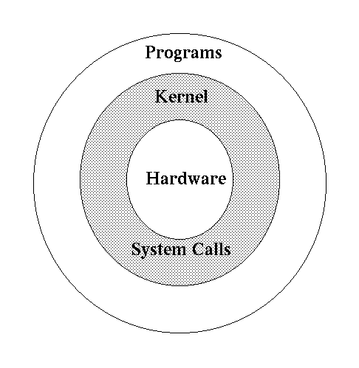
UNIX Structure
Introduction to Linux

Slide 24
UNIX File System
Introduction to Linux
Practice on online hosting OS / OVA (Open Virtualization Appliance)
https://www.onworks.net/os-distributions/rpm-based
CentOS Workstation
or download VIRTUALBOX IMAGES (ova)
https://www.linuxvmimages.com/images/centos-8/#centos-832011
centos/centos (tty or remote using ssh)
# yum -y install epel-release
# yum -y update
# yum install make gcc kernel-headers kernel-devel perl dkms bzip2
# export KERN_DIR=/usr/src/kernels/$(uname -r)
# mount -r /dev/cdrom /media
# cd /media/
# ./VBoxLinuxAdditions.run
# less /proc/modules
# find /lib/modules/$(uname -r) -type f -name ‘*.ko'
VBoxLinuxAdditions
GUI
# yum install gpm
# yum group list
# yum groupinstall ‘Server with GUI’
# cat /etc/inittab
# systemctl set-default graphical.target

Slide 25
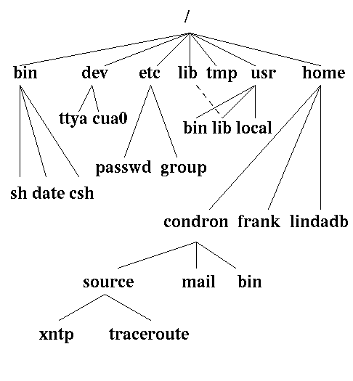
UNIX File System
Introduction to Linux

Slide 26
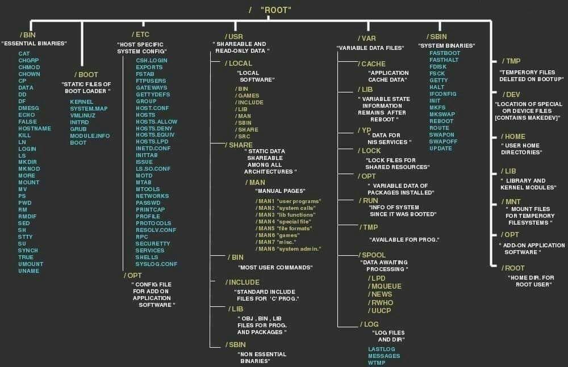
Linux directories cheat sheet
Introduction to Linux

Slide 27
File System
Introduction to Linux
The Unix file system looks like an inverted tree structure.
You start with the root directory, denoted by /, at the top and work down through sub-directories underneath it.

Slide 28
File System
Introduction to Linux
Each node is either a file or a directory of files, where the latter can contain other files and directories.
You specify a file or directory by its path name, either the full, or absolute, path name or the one relative to a location.
The full path name starts with the root, /, and follows the branches of the file system, each separated by /, until you reach the desired file, e.g.:
/home/centos/source/xntp

Slide 29
File System
Introduction to Linux
A relative path name specifies the path relative to another, usually the current working directory that you are at. Two special directories :
. the current directory
.. the parent of the current directory
So if I'm at /home/frank and wish to specify the path above in a relative fashion I could use:
../centos/source/xntp
This indicates that I should first go up one directory level, then come down through the centos directory, followed by the source directory and then to xntp.

Slide 30
Structure of Standard Directories in Unix/Linux
Introduction to Linux
/ (root directory) The ancestor of all directories on the system; all other directories are subdirectories of this directory, either directly or through other subdirectories.
/boot Contains all files and directories that are needed to boot the Linux kernel.
/bin Essential tools and other programs (or binaries).
/dev Files representing the system's various hardware devices. For example, you use the file `/dev/cdrom' to access the CD−ROM drive.
/etc Miscellaneous system configuration files, startup files, etc.

Slide 31
Structure of Standard Directories in Unix/Linux
Introduction to Linux
/home The home directories for all of the system's users.
/lib Essential system library files used by tools in `/bin'.
/proc Files that give information about current system processes and kernel information.
/root The superuser's home directory, whose username is root. (In the past, the home directory for the superuser was simply `/'; later, `/root' was adopted for this purpose to reduce clutter in `/'.)

Slide 32
Structure of Standard Directories in Unix/Linux
Introduction to Linux
/sbin Essential system administrator tools, or system binaries.
/tmp Temporary files.
/usr Subdirectories with files related to user tools and applications.
/media, Contain directories that are used for mounting devices in the file system /mnt tree.
/opt Used for optional packages that may be installed on your server.
/run Contains process and user-specific information that has been created since the last boot.
/srv May be used for data by services like NFS, FTP, and HTTP.
/sys Used as an interface to different hardware devices that is managed by the Linux kernel and associated processes.
/var Contains files that may change in size dynamically, such as log files, mail boxes, and spool files.

Slide 33
Directories, Files and Inodes
Introduction to Linux
Every directory and file is listed in its parent directory.
In the case of the root directory, that parent is itself.
A directory is a file that contains a table listing the files contained within it, giving file names to the inode numbers in the list.
The information about all the files and directories is maintained in INODE TABLE
An Inode (Index Nodes) is an entry in the table containing information about a file (metadata) including file permissions, UID, GID, size, time stamp, pointers to files data blocks on the disk etc.

Slide 34
Basic Shell Skills
Introduction to Linux
The shell is the default working environment for a Linux administrator. It is the environment where users and administrators enter commands that are executed by the operating system. Different shells for Linux are available, but Bash is the most common shell. (see /etc/shells)
Working with the shell is all about working with command syntax. Typically, command syntax has three basic parts: the command, its options, and its arguments.
The command is the command itself, such as ls. This command shows a list of files in the current directory. To modify the behavior of the command, you can use options. Options are a part of the program code, and they modify what the command is doing. For instance, when you use the -l option with the ls command, a long listing of filenames and properties is displayed.
The word argument is a bit confusing. The command ls -l /etc has two different arguments: -l and /etc. The first argument is an option, modifying the behavior of the command. The second argument is a target, specifying where the command should do its work.

Slide 35
Basic Shell Skills
Introduction to Linux
The purpose of the Linux shell is to provide an environment in which commands can be executed. The shell takes care of interpreting the command that a user has entered correctly. To do this, the shell makes a distinction between three kinds of commands:
Aliases
Internal commands
External commands
An alias is a command that a user can define as needed. Some aliases are provided by default; type alias on the command line to get an overview. To define an alias, use alias newcommand='oldcommand', as in the default alias ll='ls -l --color=auto' that has already been created on your system.
An internal command is a command that is a part of the shell itself and, as such, doesn’t have to be loaded from disk separately.
An external command is a command that exists as an executable file on the disk of the computer.

Slide 36
Users, Groups and Access Permissions
Introduction to Linux
In UNIX/LINUX, there is a concept of user and an associated group
The system determines whether or not a user or group can access a file or program based on the permissions assigned to them.
Apart from all the users, there is a special user called Super User or the root which has permission to access any file and directory

Slide 37
Access Permissions
Introduction to Linux
There are three permissions for any file, directory or application program.
The following lists the symbols used to denote each, along with a brief description:
r — Indicates that a given category of user can read a file.
w — Indicates that a given category of user can write to a file.
x — Indicates that a given category of user can execute the file.

Slide 38
Access Permissions
Introduction to Linux
Each of the three permissions are assigned to three defined categories of users.
The categories are:
owner — The owner of the file or
application.
group — The group that owns the file or application.
others — All users with access to the
system.

Slide 39
Access Permissions
Introduction to Linux
One can easily view the permissions for a file by invoking a long format listing using the command ls -l.
For instance, if the user centos creates an executable file named test, the output of the command ls -l test would look like this:
-rwxrwxr-x 1 centos centos 0 Sep 26 12:25 test

Slide 40
Access Permissions
Introduction to Linux
The permissions for this file are listed are listed at the start of the line, starting with rwx.
This first set of symbols define owner access.
The next set of rwx symbols define group access
The last set of symbols defining access permitted for all other users.
-rwxrwxr-x 1 centos centos 0 Sep 26 12:25 test

Slide 41
Access Permissions
Introduction to Linux
This listing indicates that the file is readable, writable, and executable by the user who owns the file (user centos) as well as the group owning the file (which is a group named centos).
The file is also world-readable and world-executable, but not world-writable.
-rwxrwxr-x 1 centos centos 0 Sep 26 12:25 test

Slide 42
Listing the Content of a Directory
Introduction to Linux
ls is used to list the contents of a directory.
If the command ls is written with parameter –l then the command lists contents of the working directory with details. Example:
$ ls –l

Slide 43
Moving in Directories
Introduction to Linux
mkdir try_it
cd try_it
Changes the directory to try_it
pwd Prints present working directory (e.g. /home/kiosk/try_it)
cd .. Move to superior directory
pwd : Prints /home/kiosk
cd /home The absolute path
pwd : Prints /home
cd The system is returned to the user home directory
pwd : Print /home/kiosk

Slide 44
Make Directory
Introduction to Linux
The command mkdir my_dir
makes new directory my_dir (the path is given relative) as a subdirectory of the current directory.

Slide 45
Remove Directory
Introduction to Linux
The command rmdir your_dir
removes directory your_dir if it is empty.

Slide 46
Copy File
Introduction to Linux
The command cp file_1 file_2
copies file_1 to file_2. The both files must be in the same working directory. If they are in various directories, the path must be given.
cp file_1 /tmp/
ls /bin |less

Slide 47
Rename and/or Move the File
Introduction to Linux
The command mv file_1 file_2
moves file_1 to file_2
The both files must be in the same working directory.
If they are in different directories, the path must be given.
The file_1 is removed from the disk.

Slide 48
Remove File
Introduction to Linux
The command rm file_a
removes the file_a from the system
If you use wildcard. For example
rm h*c
you will remove all files beginning with h and ending with c which are in working directory.
If you write
rm *
you will erase all files from your working directory.

Slide 49
Access Permission of File/Directory
Introduction to Linux
The ownership of the file or directory can be changed using the command
chown <owner> <file/directory name>
The group of the file or directory can be changed using the command
chgrp <group> <file/directory name>
The permissions of the file can be changed using chmod command
chmod -R ### <filename or directory>
-R is optional and when used with directories will traverse all the sub-directories of the target directory changing ALL the permissions to ###.

Slide 50

Access Permission of File/Directory using Octal Notation
Introduction to Linux
The #'s can be:
0 = Nothing 1 = Execute 2 = Write 3 = Execute & Write (2 + 1) 4 = Read 5 = Execute & Read (4 + 1) 6 = Read & Write (4 + 2) 7 = Execute & Read & Write (4 + 2 + 1)
RWX

Slide 51
Access Permission of File/Directory Using Symbolic Notation
Introduction to Linux
the following symbols are used for file permissions. Here roles are
User(u), Group(g), Others(o) and the permissions are
Read(r), Write(w), Execute(x)
you can combine any symbols to set permission together like User+Group (ug), User+Group+Other (ugo), User+Other(uo).

Slide 52
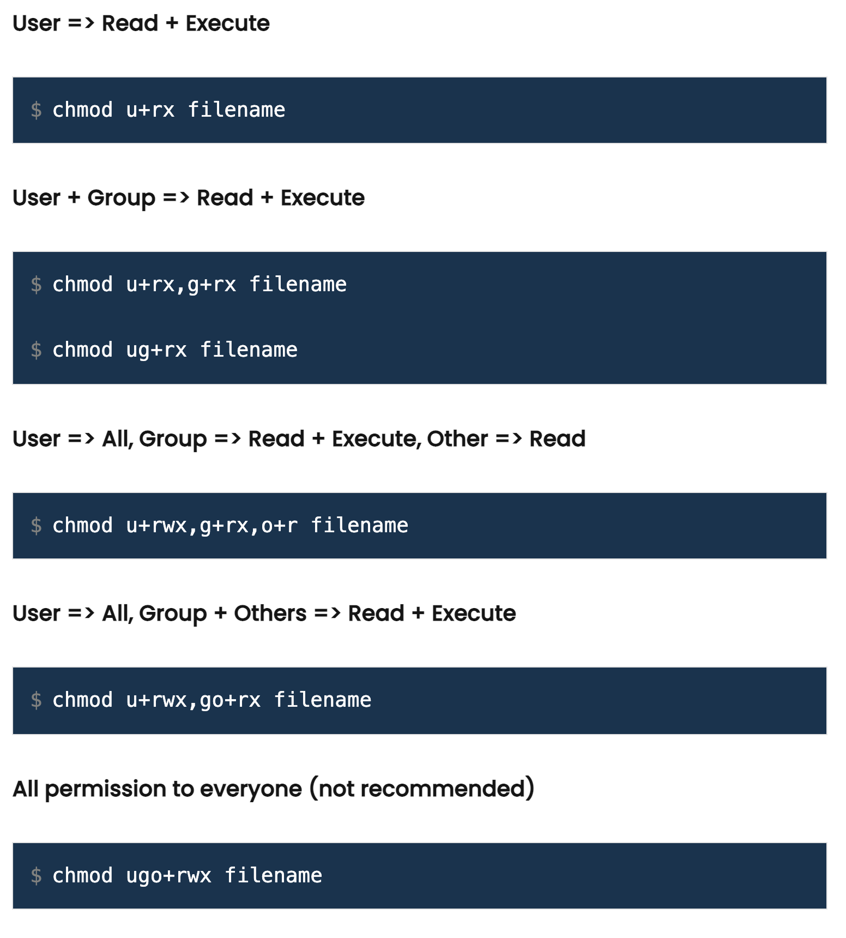
Access Permission of File/Directory Using Symbolic Notation
Introduction to Linux

Slide 53
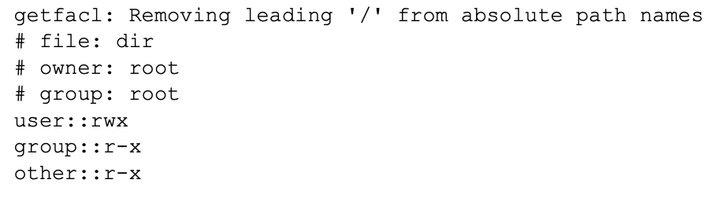
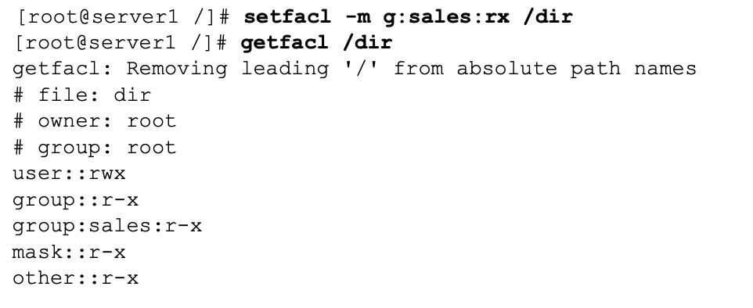
ACLs
Introduction to Linux
Access control list (ACL) provides an additional, more flexible permission mechanism for file systems. It is designed to assist with UNIX file permissions. ACL allows you to give permissions for any user or group to any disc resource.
show current ACL settings using getfacl
to set ACLs, you use the setfacl command
One benefit of using ACLs is that you can give permissions to more than one user or group at a directory. Another benefit is that you can enable inheritance by working with default ACLs.

Slide 54
Quiz(1)
Introduction to Linux
Which statement about privileged users (root) is true? a. A privileged user is a user who has access to a Linux system. b. A privileged user with no access permissions can do nothing at all. c. Privileged users are not restricted in any way. d. On every server, at least one privileged user must be manually created while installing the server.
On a default installation of an RHEL 8 server, which group does the user typically need to be a member of to be able to use sudo to run all administration commands? a. admin b. root c. sys d. wheel
There are different ways that users can run tasks with root permissions. Which of the following is not one of them? a. sudo b. runas c. su d. PolicyKit
Which of the following is used to store the hash of the user’s encrypted password? a. /etc/passwd b. /etc/shadow c. /etc/users d. /etc/secure
Which configuration file should you change to set the default location for all new user home directories? a. /etc/login.defaults b. /etc/login.defs c. /etc/default/useradd d. /etc/default/login.defs
Notes:
1. C. Privileged users are the opposite of unprivileged users. A privileged user can execute tasks in kernel space, without further restriction. By default, only the user root exists as a privileged user.
2. D. In the sudo configuration file, all members of the group wheel by default get access to all administrator tasks.
3. B. The runas command does not exist on Linux.
4. B. The hashed user passwords are stored in /etc/shadow.
5. C. The file /etc/default/useradd is read for default settings when new user accounts are created.

Slide 55
Quiz(1)
Introduction to Linux
6. Which command enables you to get information about password properties such as password expiry? a. chage -l b. usermod --show c. passwd -l d. chage --show
7. Which of the following files is not processed when a user starts a login shell? a. /etc/profile b. /etc/.profile c. ~/.bashrc d. ~/.bash_profile
8. Which utility can be used to edit group membership directly through the appropriate configuration file? a. vigr b. vipw c. vipasswd d. usermod
9. Which command can be used to list all groups a user is member of? a. userlist b. grouplist c. id d. groups
10. What can you do to ensure that no users, except for the user root, can log in temporarily? a. Set the default shell to /usr/sbin/nologin b. Set the default shell to /bin/false c. Create a file with the name /etc/nologin d. Create a file with the name /etc/nologin.txt
Notes:
6. A. The chage -l command enables you to manage password properties.
7. B. There is no file /etc/.profile.
8. A. The vigr command creates a copy of the /etc/group file so that changes can be applied safely.
9. C and D. The id and groups commands show a list of all groups a user is a member of.
10. D. When a file with the name /etc/nologin.txt is created, only the root user is allowed to log in, and nobody else. In this file you can specify a message that will be shown to users who are trying to log in.

Slide 56
Quiz(2)
Introduction to Linux
1. A user needs to work in a session where all new files that he creates will be group-owned by the group sales, until the session is closed. Which command would do that? a. chgrp sales b. setgid sales c. newgrp sales d. setgroup sales
2. Which command enables you to find all files on a system that are owned by user linda? a. find / -user linda b. find / -uid linda c. ls -l | grep linda d. ls -R | find linda
3. Which command does not set group ownership to the group sales for the file myfile? a. chgrp sales myfile b. chown .sales myfile c. chgrp myfile sales d. chown :sales myfile
4. Which command would be used to allow read and write permissions to the user and group owners and no permissions at all to anyone else? a. chown 007 filename b. chmod 077 filename c. chmod 660 filename d. chmod 770 filename
5. Which command enables you to set the SGID permission on a directory? a. chmod u+s /dir b. chmod g-s /dir c. chmod g+s /dir d. chmod 1770 /dir
Notes:
1. C. The newgrp command is used to set the effective primary group, which will affect default group ownership on new files until the current shell session is ended. The chgrp command is used to set the group owner of an existing file; chgrp is not related to any user account, and it affects newly created files only.
2. A. The find / -user linda command searches all files that are owned by user linda. Notice that find also has a -uid option that allows you to locate files based on a specific UID setting. This does not allow you to search files based on a username, but it will let you find files based on the UID of a specific user.
3. C. chgrp myfile sales does not set group ownership for the file myfile. The order in this command is wrong; chgrp first needs the name of the group, followed by the name of the owner that needs to be set.
4. C. When used in relative mode, the three digits are used to specify user, group, and others permissions. The value 6 is used to apply read and write.
5. C. The chmod g+s /dir command adds (+) the SGID permission to /dir. chmod u+s /dir adds SUID to the directory, chmod g-s /dir removes the SGID permission, and the 1 in chmod 1770 /dir would set sticky bit and not SGID.

Slide 57
Quiz(2)
Introduction to Linux
6. You are trying to use the setfacl command to set ACLs on the directory /data, but you are getting an “operation not supported” message. Which of the following is the most likely explanation? a. The setfacl command is not installed on your computer. b. You are making an error typing the command. c. The user or group to which you want to grant ACLs does not exist. d. The file system lacks ACL support.
7. Which command grants rw permissions for the group sales to all new files that will be created in the /data directory and all of its subdirectories? a. setfacl -m d:g:sales:rw /data b. setfacl -m d:g:sales:rwx /data c. setfacl -R -m g:sales:rwx /data d. setfacl -R -m g:sales:rw /data
8. Which command enables you to make sure that others have no access to any new files that will be created in the /data directory, assuming that you want others to have read permissions on all other files? a. setfacl -m d:o::- /data b. setfacl -m o::- /data c. umask 027 /data d. umask 027
9. Which of the following umask settings meets the following requirements: Grants all permissions to the owner of the file. Grants read permissions to the group owner of the file. Grants no permissions to others. a. 740 b. 750 c. 027 d. 047
10. Which command enables you to check all attributes that are currently set on myfile. a. ls --attr myfile b. getattr myfile c. lsattr myfile d. listattr myfile
Notes:
6. D. ACL support is not offered by default on all file systems. If you get an “operation not supported” error message, make sure to add the acl mount option and remount the file system. Note that this is not required on RHEL 8 XFS, where ACL support is set by default.
7. B. Although answers A and B will both set default ACLs, answer B is better because it adds x to the permissions. Without x, members of the group sales will have no way to enter the directory using the cd command.
8. A. The umask is a system-wide setting and cannot be used to apply to specific directories only. Use a default ACL as shown in answer A to perform this task.
9. C. In a umask, 0 in the first position gives all permissions to the file owner, 2 in the second position ensures that members of the group owner can read files, and 7 in the third position takes away all permissions for others.
10. C. The lsattr command shows current attribute settings to files. The ls command is not capable of showing file attributes, and the other commands that are listed do not exist.

Slide 58
Assignment (1)
Introduction to Linux
Login as centos (password is centos)
Find the present Directory
Print the / directory structure
Print a few commands available in /bin and /sbin directory
Locate the centos directory
Print the permissions of centos directory
Create a new Directory test in centos directory
Print the permissions of test directory
Copy the file /etc/resolv.conf in test directory
Rename the test directory to testing
Delete the testing directory
Change the permissions of centos directory to 775
Login as root user (password is centos)
Change the permissions of /tmp directory to 700
Change the permissions of centos directory to 700
The location of kernel files in Unix File System is /boot and by looking at the kernel file, print the kernel version you are using in your system.
https://unix.stackexchange.com/questions/71622/what-are-correct-permissions-for-tmp-i-unintentionally-set-it-all-public-recu

Slide 59
Assignment (2)
Introduction to Linux
Login as guest
Change directory to /
List the contents of /home directory
Find the group to which guest belongs
Create a file syslinus in the home area of guest (hint: use touch command)
Find the permissions of the file syslinus
Find the inode number of file syslinus (hint: ls –li)
Copy the file syslinus to syslinus1
Find the inode number of file syslinus1 (hint: ls –li)
Move the file syslinus to syslinus2
Find the inode number of file syslinus2 (hint: ls –li)
Move syslinus2 to syslinus
Login as root
Create a new user guest1 with same group as guest (hint: use GUI tool Applications→System Settings→ Users and Groups)[More on this later in the course]
Create a new user guest2 with a different group than the group of guest (hint: use GUI tool Applications→System Settings→ Users and Groups)
Find, what permissions should the file syslinus have, so that both guest1 and guest2 can write into this file.

